Slide 1
Advances in the Treatment of
Small-Cell Lung Cancer
David R. Spigel, M.D.
Sarah Cannon Research Institute
January 2026

Slide 2
Disclosures
Leadership (No Personal or Institutional Payment)
ASCO NSCLC Guideline Committee Member
Consulting (No Personal Payment; Payment to Sarah Cannon)
Amgen, AstraZeneca, Bayer, Bristol-Myers Squibb, Celgene, Curio Science, Dracen Pharmaceuticals, EMD Serono, Evelo Biosciences, Exelixis, GlaxoSmithKline, Iksuda Therapeutics, Intellisphere, Illumina, Ipsen Biopharmaceuticals, Janssen, Jazz Pharmaceuticals, Lilly, Merck, Mirati, Molecular Templates, Nektar Therapeutics, Novartis, Novocure, Pfizer, Pharma Mar, Puma Biotechnology, Roche/Genentech, Sanofi-Aventis, Seattle Genetics, Takeda, TRIPTYCH Health Partners, TRM Oncology, Williams and Connolly LLP, Regeneron Pharmaceuticals
Contracted Research (No Personal Payment; Payment to Sarah Cannon)
Aeglea Biotherapeutics, Astellas, AstraZeneca, BIND Therapeutics, Bristol-Myers Squibb, Calithera, Celgene, Celldex, Clovis, Daiichi Sankyo, Eisai, Elevation Oncology, Lilly, EMD Serono, G1 Therapeutics, Roche/Genentech, GlaxoSmithKline, GRAIL, ImClone Systems, ImmunoGen, Ipsen, Janssen, MedImmune, Merck, Molecular Partners, Nektar, Neon, Novartis, Novocure, Takeda, Tesaro, Transgene, UT Southwestern, Agios, Cyteir Therapeutics, Apollomics

Slide 3
Outline
LS-SCLC
ES-SCLC (First-Line, Relapsed)
Emerging Therapies

Slide 4
The Workup

Slide 5
The Workup of SCLC
CTs - C/A/P
MRI – Brain
Genetic sequencing
Hospital Care

Slide 6
The Workup of SCLC
Hospital Care
Initiating therapy
ICU
Emergent/Urgent
SVC
Cord compression
CNS mets
TLS

Slide 7
LS-SCLC

Slide 8
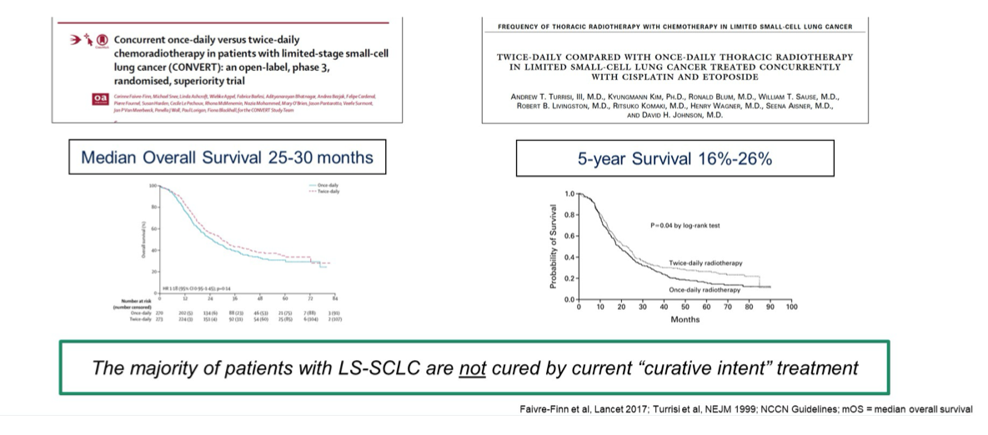

Slide 9
ADRIATIC
Phase 3, randomized, double-blind, placebo-controlled, multicenter, international study (NCT03703297)
Stage I–III LS-SCLC
(stage I/II inoperable)
WHO PS 0 or 1
Had not progressed following cCRT*
PCI* permitted before randomization
Durvalumab
1500 mg Q4W
N=264
Dual primary endpoints:
Durvalumab vs placebo
  OS
  PFS (by BICR, per RECIST v1.1)
Key secondary endpoints:
Durvalumab + tremelimumab vs placebo
  OS
  PFS (by BICR, per RECIST v1.1)
  Other secondary endpoints:
OS/PFS landmarks
Safety
N=730
Placebo
Q4W
N=266
R‡
cCRT components
Four cycles of platinum and
etoposide (three permitted†)
RT: 60–66 Gy QD over 6 weeks
or 45 Gy BID over 3 weeks
RT must commence no later than end of cycle 2 of CT
Stratified by:
Disease stage
(I/Il vs III)
PCI (yes vs no)
Durvalumab + tremelimumab
D 1500 mg Q4W + T 75 mg Q4W for 4 doses, followed by D 1500 mg Q4W
N=200
Treatment until investigator-determined progression or
intolerable toxicity, or for a maximum of 24 months
*cCRT and PCI treatment, if received per local standard of care, must have been completed within 1‒42 days prior to randomization.
†If disease control was achieved and no additional benefit was expected with an additional cycle of chemotherapy, in the opinion of the investigator.
‡The first 600 patients were randomized in a 1:1:1 ratio to the 3 treatment arms; subsequent patients were randomized 1:1 to either durvalumab or placebo.
BICR, blinded independent central review; BID, twice daily; CT, chemotherapy; D, durvalumab; PCI, prophylactic cranial irradiation; PS, performance status; Q4W, every 4 weeks;
QD, once daily; RECIST, Response Evaluation Criteria in Solid Tumors;
RT, radiotherapy; T, tremelimumab; WHO, World Health Organization.
Cheng, NEJM 2024

Slide 10
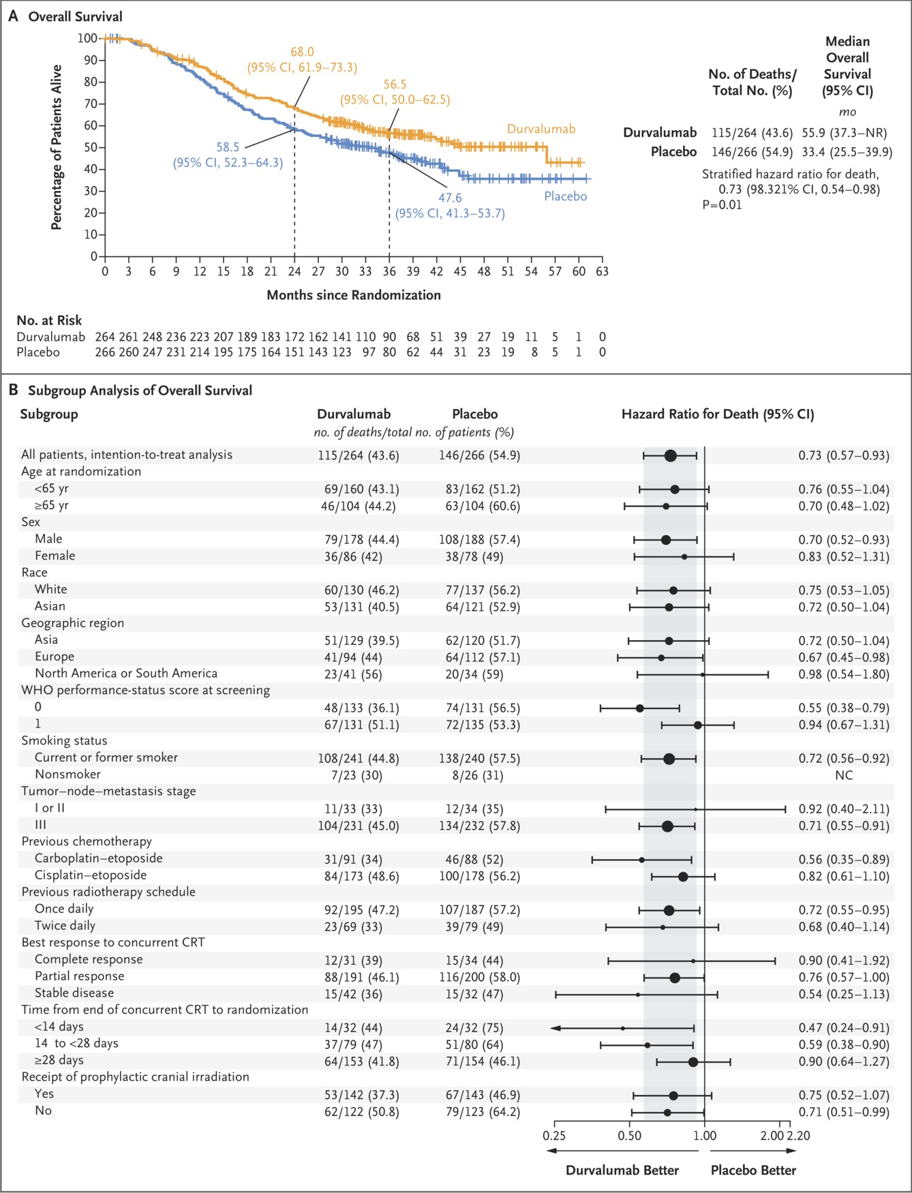
ADRIATIC OS
Cheng Y et al. N Engl J Med2024;391:1313-1327
Cheng, NEJM 2024
Notes:
Figure 2 Progression-free Survival (Intention-to-Treat Population). Progression-free survival was defined as the time from date of randomization to date of objective disease progression or death from any cause in the absence of progression. Of the 139 patients in the durvalumab group and the 169 patients in the placebo group who had disease progression or died, 126 and 158, respectively, had progression as assessed on the basis of Response Evaluation Criteria in Solid Tumors, version 1.1 (progression in target lesions in 31 patients in the durvalumab group and 31 in the placebo group, in nontarget lesions in 5 and 13, and as new lesions in 94 and 128; categories not mutually exclusive), and 13 and 11 patients, respectively, died in the absence of disease progression. Panel A shows Kaplan–Meier curves for progression-free survival as assessed by means of blinded independent central review. Tick marks indicate censored data, and dashed lines the times of the landmark analyses at 18 months and 24 months. Formal testing for the proportional-hazards assumption provided a P value of 0.79, indicating the plausibility of the assumption. Panel B shows progression-free survival in prespecified subgroups. The size of the circle is proportional to number of events across the two trial groups. The arrow indicates that the 95% confidence interval extends outside the graphed area.

Slide 11
ADRIATIC OS
Cheng, NEJM 2024
Notes:
Figure 1 Overall Survival (Intention-to-Treat Population). Panel A shows Kaplan–Meier curves for overall survival, defined as the time from date of randomization until death from any cause. Tick marks indicate censored data, and dashed lines the times of the landmark analyses at 24 months and 36 months. Formal testing for the proportional-hazards assumption provided a P value of 0.91, which indicated the plausibility of the assumption. NR denotes not reached. Panel B shows overall survival in prespecified subgroups. The size of the circle is proportional to number of events across the two trial groups. Race was reported by the patient. World Health Organization (WHO) performance-status scores range from 0 to 5, with higher numbers indicating greater disability. The hazard ratio in the subgroup of nonsmokers could not be calculated (NC) because fewer than 10 deaths occurred in each group. The arrow indicates that the 95% confidence interval extends outside the graphed area. CRT denotes chemoradiotherapy.

Slide 12
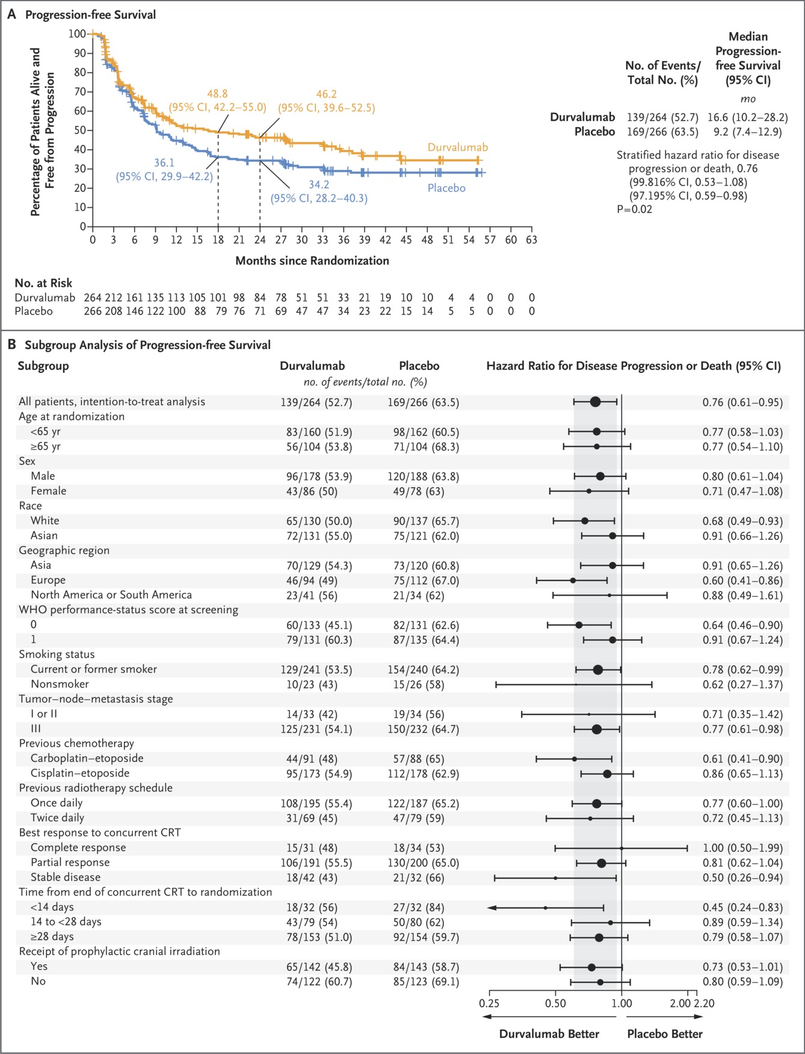
ADRIATIC PFS
Cheng Y et al. N Engl J Med2024;391:1313-1327
Cheng, NEJM 2024
Notes:
Figure 2 Progression-free Survival (Intention-to-Treat Population). Progression-free survival was defined as the time from date of randomization to date of objective disease progression or death from any cause in the absence of progression. Of the 139 patients in the durvalumab group and the 169 patients in the placebo group who had disease progression or died, 126 and 158, respectively, had progression as assessed on the basis of Response Evaluation Criteria in Solid Tumors, version 1.1 (progression in target lesions in 31 patients in the durvalumab group and 31 in the placebo group, in nontarget lesions in 5 and 13, and as new lesions in 94 and 128; categories not mutually exclusive), and 13 and 11 patients, respectively, died in the absence of disease progression. Panel A shows Kaplan–Meier curves for progression-free survival as assessed by means of blinded independent central review. Tick marks indicate censored data, and dashed lines the times of the landmark analyses at 18 months and 24 months. Formal testing for the proportional-hazards assumption provided a P value of 0.79, indicating the plausibility of the assumption. Panel B shows progression-free survival in prespecified subgroups. The size of the circle is proportional to number of events across the two trial groups. The arrow indicates that the 95% confidence interval extends outside the graphed area.

Slide 13
ADRIATIC PFS
Cheng Y et al. N Engl J Med2024;391:1313-1327
Cheng, NEJM 2024
Notes:
Figure 2 Progression-free Survival (Intention-to-Treat Population). Progression-free survival was defined as the time from date of randomization to date of objective disease progression or death from any cause in the absence of progression. Of the 139 patients in the durvalumab group and the 169 patients in the placebo group who had disease progression or died, 126 and 158, respectively, had progression as assessed on the basis of Response Evaluation Criteria in Solid Tumors, version 1.1 (progression in target lesions in 31 patients in the durvalumab group and 31 in the placebo group, in nontarget lesions in 5 and 13, and as new lesions in 94 and 128; categories not mutually exclusive), and 13 and 11 patients, respectively, died in the absence of disease progression. Panel A shows Kaplan–Meier curves for progression-free survival as assessed by means of blinded independent central review. Tick marks indicate censored data, and dashed lines the times of the landmark analyses at 18 months and 24 months. Formal testing for the proportional-hazards assumption provided a P value of 0.79, indicating the plausibility of the assumption. Panel B shows progression-free survival in prespecified subgroups. The size of the circle is proportional to number of events across the two trial groups. The arrow indicates that the 95% confidence interval extends outside the graphed area.

Slide 14
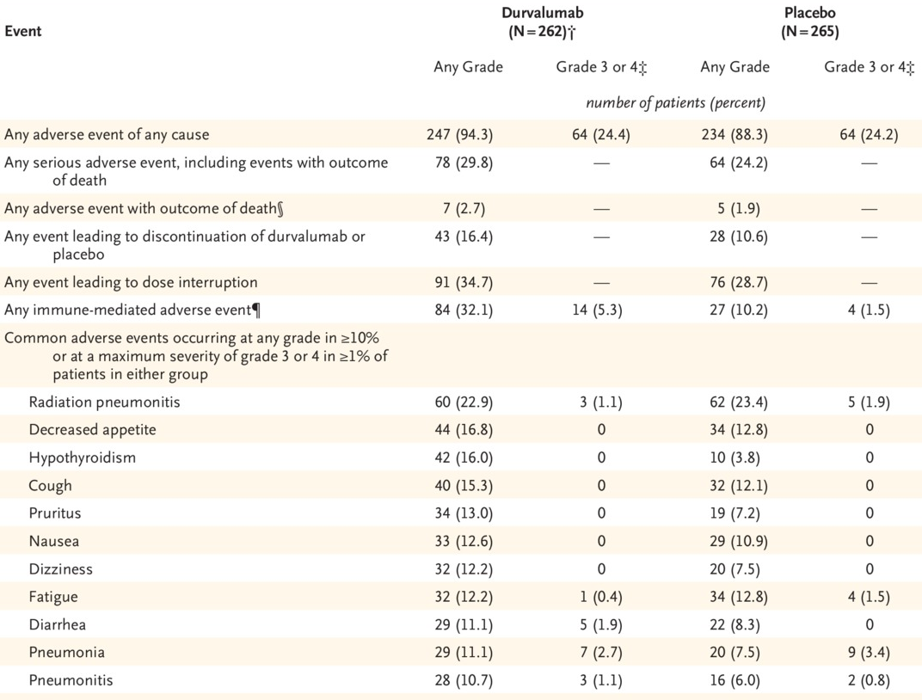
Adverse Events (Safety Population).
Cheng Y et al. N Engl J Med2024;391:1313-1327
Cheng, NEJM 2024
Notes:
Table 3 Adverse Events (Safety Population).

Slide 15
ES-SCLC

Slide 16
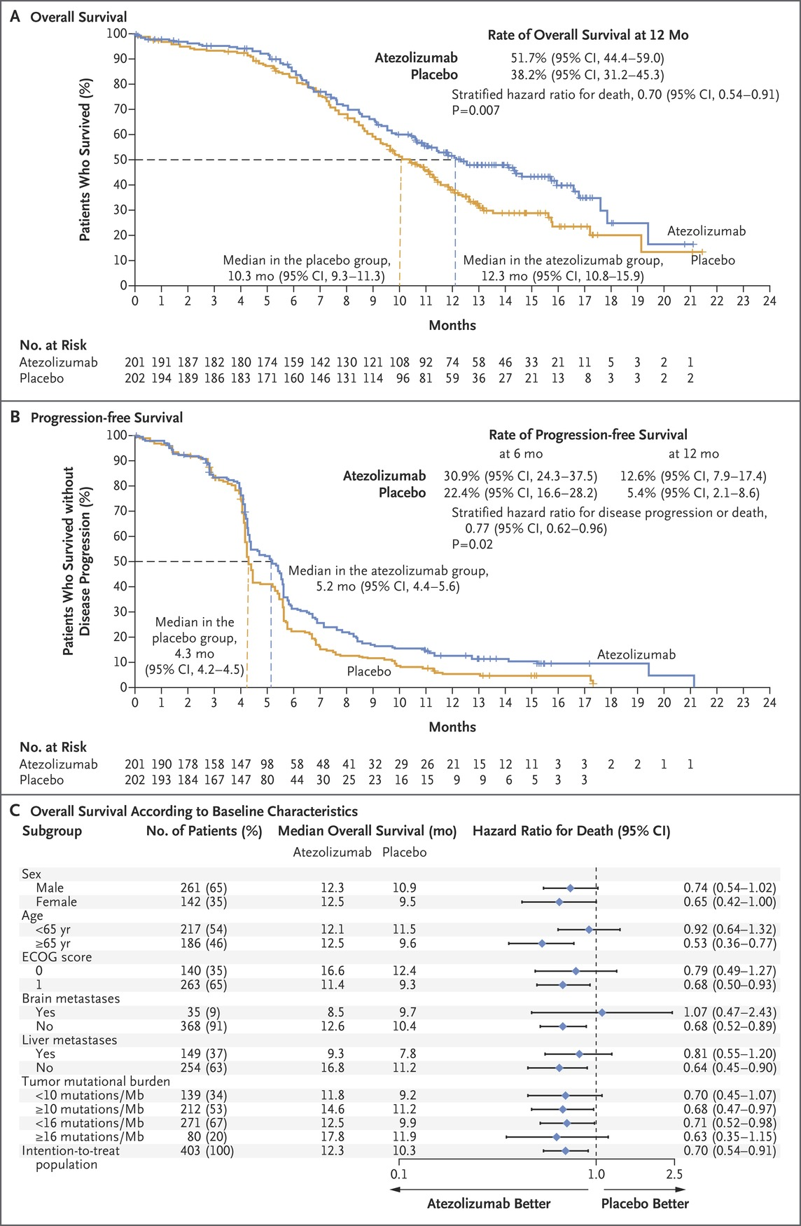
IMpower 133 OS: Chemotherapy +/- Atezolizumab
in First-Line ES-SCLC
Horn, NEJM 2018
Notes:
Figure 2 Overall Survival and Investigator-Assessed Progression-free Survival in the Intention-to-Treat Population. Panel A shows the Kaplan–Meier estimates of overall survival, and Panel B the Kaplan–Meier estimates of investigator-assessed progression-free survival. Tick marks indicate censored data. Panel C shows a subgroup analysis of overall survival according to baseline characteristics. Eastern Cooperative Oncology Group (ECOG) performance-status scores range from 0 to 5, with higher scores reflecting greater disability. Tumor mutational burden was assessed with the use of a blood-based assay.

Slide 17
IMpower 133 PFS
Horn, NEJM 2018
Notes:
Figure 2 Overall Survival and Investigator-Assessed Progression-free Survival in the Intention-to-Treat Population. Panel A shows the Kaplan–Meier estimates of overall survival, and Panel B the Kaplan–Meier estimates of investigator-assessed progression-free survival. Tick marks indicate censored data. Panel C shows a subgroup analysis of overall survival according to baseline characteristics. Eastern Cooperative Oncology Group (ECOG) performance-status scores range from 0 to 5, with higher scores reflecting greater disability. Tumor mutational burden was assessed with the use of a blood-based assay.

Slide 18
IMpower 133 OS
Horn, NEJM 2018
Notes:
Figure 2 Overall Survival and Investigator-Assessed Progression-free Survival in the Intention-to-Treat Population. Panel A shows the Kaplan–Meier estimates of overall survival, and Panel B the Kaplan–Meier estimates of investigator-assessed progression-free survival. Tick marks indicate censored data. Panel C shows a subgroup analysis of overall survival according to baseline characteristics. Eastern Cooperative Oncology Group (ECOG) performance-status scores range from 0 to 5, with higher scores reflecting greater disability. Tumor mutational burden was assessed with the use of a blood-based assay.

Slide 19
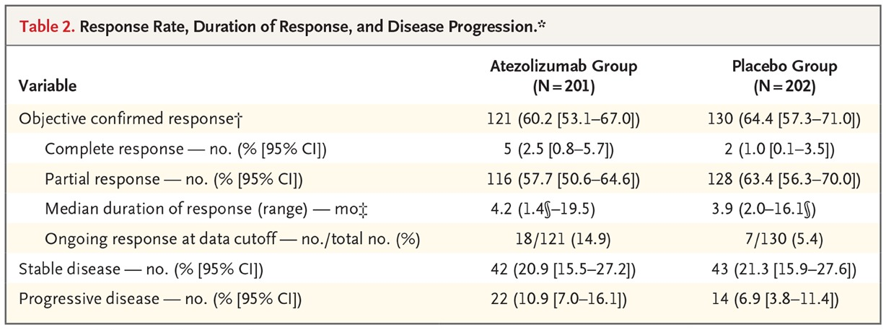
IMpower 133 ORR
Horn, NEJM 2018
Notes:
Figure 2 Overall Survival and Investigator-Assessed Progression-free Survival in the Intention-to-Treat Population. Panel A shows the Kaplan–Meier estimates of overall survival, and Panel B the Kaplan–Meier estimates of investigator-assessed progression-free survival. Tick marks indicate censored data. Panel C shows a subgroup analysis of overall survival according to baseline characteristics. Eastern Cooperative Oncology Group (ECOG) performance-status scores range from 0 to 5, with higher scores reflecting greater disability. Tumor mutational burden was assessed with the use of a blood-based assay.

Slide 20
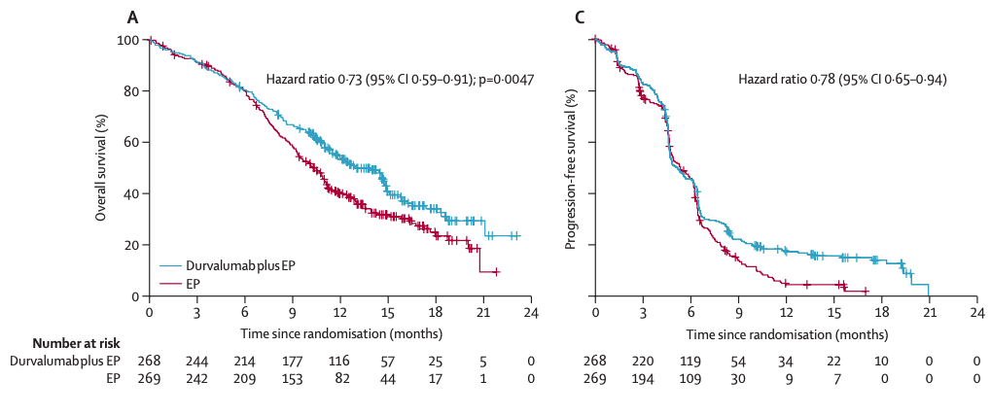
CASPIAN OS and PFS:
Chemotherapy + Durvalumab v. Chemotherapy
in First-Line ES-SCLC
Paz-Ares, Lancet 2019

Slide 21
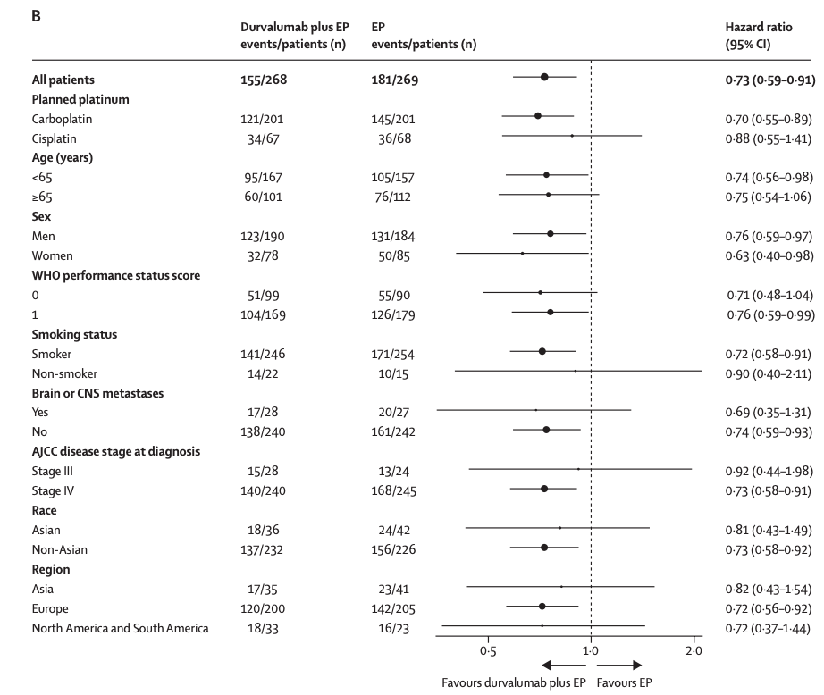
CASPIAN OS
Paz-Ares, Lancet 2019

Slide 22
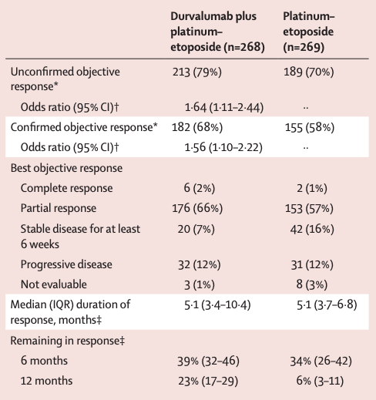
CASPIAN ORR
Paz-Ares, Lancet 2019

Slide 23
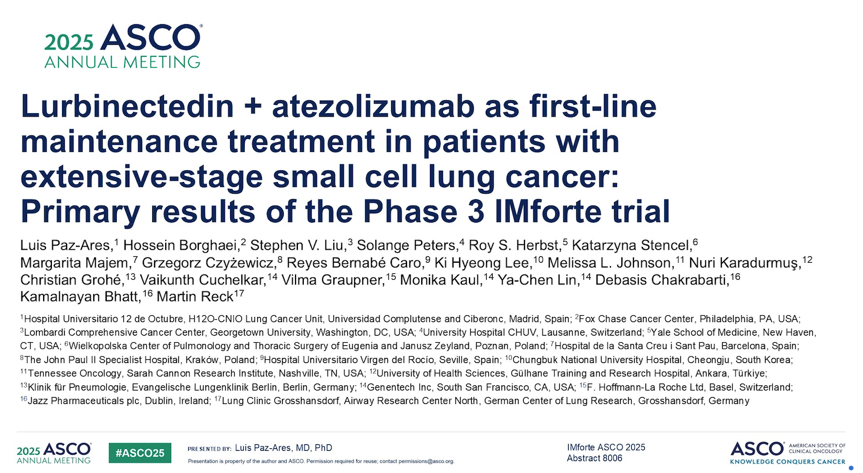

Slide 24
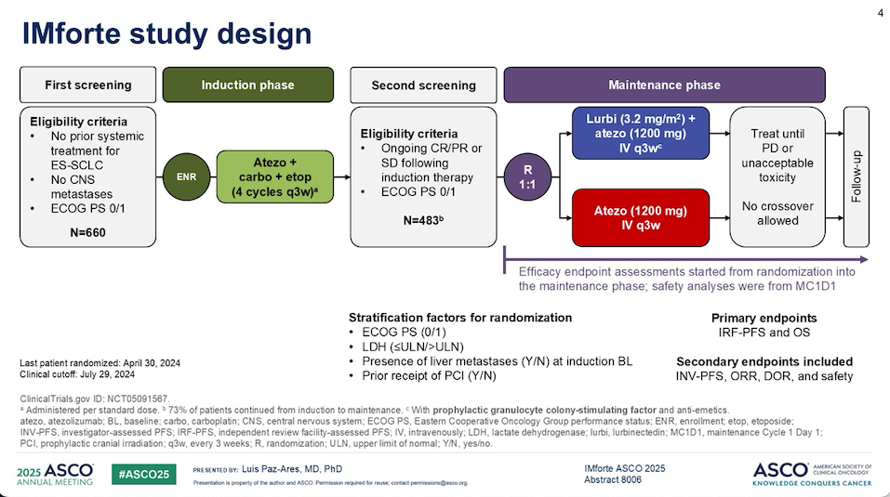

Slide 25
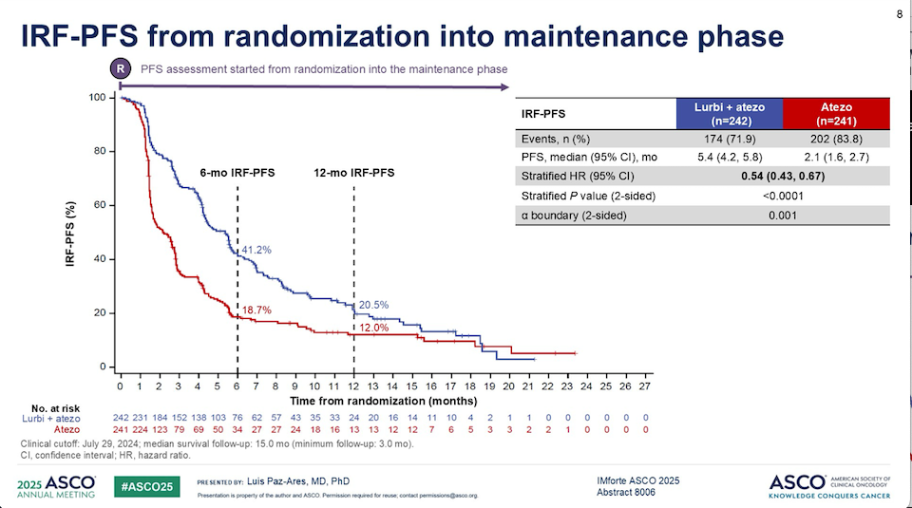

Slide 26
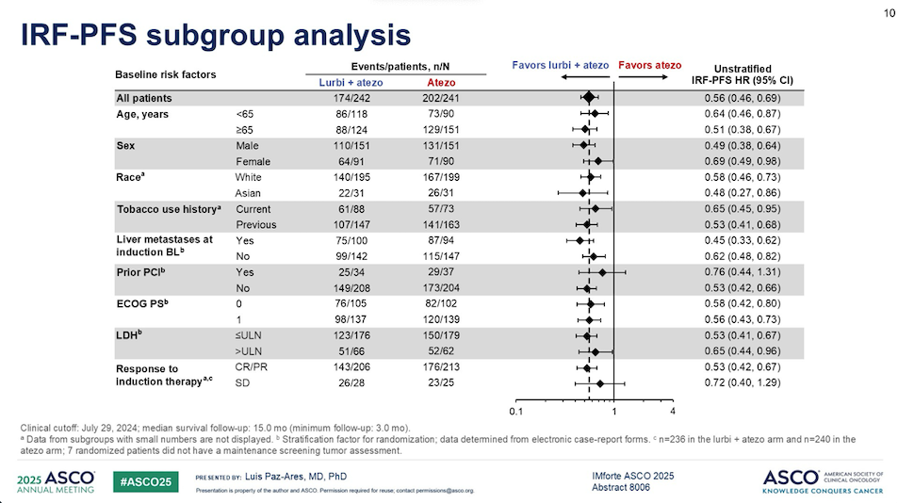

Slide 27
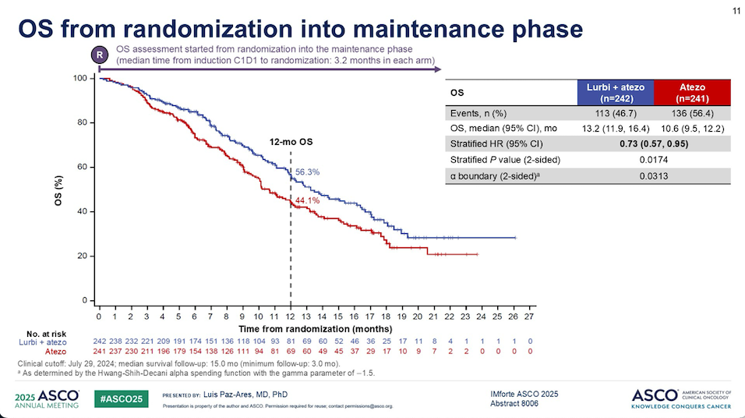

Slide 28
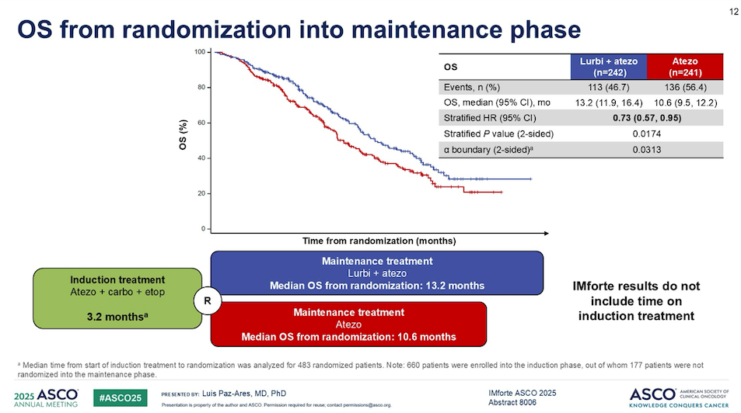

Slide 29
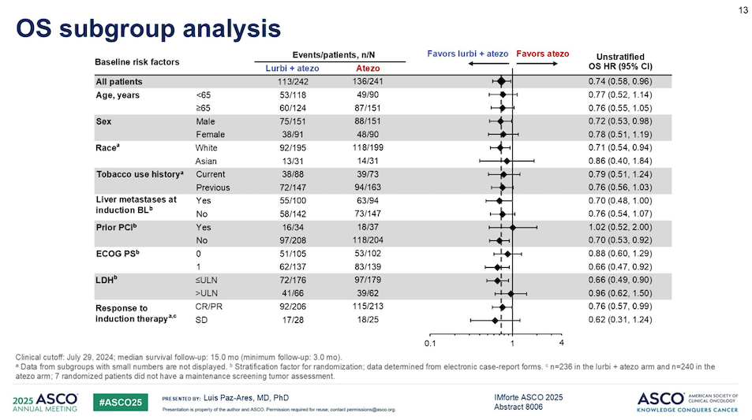

Slide 30
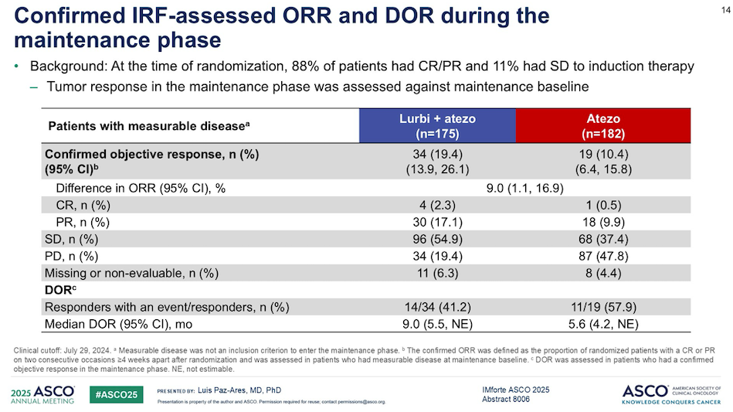

Slide 31
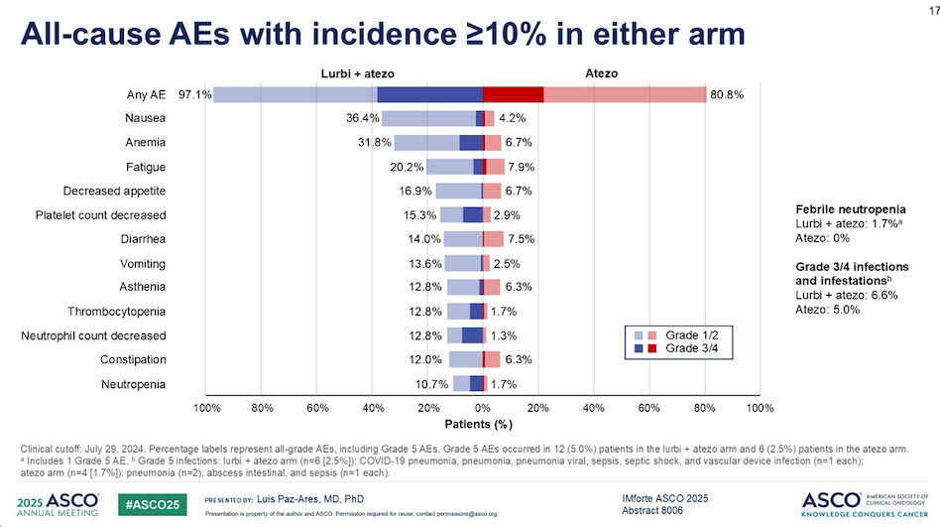

Slide 32
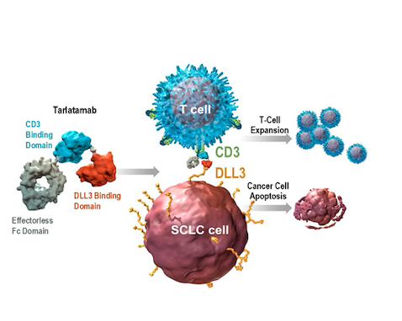
Tarlatamab
Rudin, ASCO 2025
Notes:
Figure 1 Antitumor Activity of Tarlatamab. Panel A shows the time to response, the duration of response, and patient status as of the data cutoff date for all the patients who were assessed as having an objective response (complete or partial response; primary end point) to 10 mg or 100 mg of tarlatamab, as assessed by blinded independent central review according to the Response Evaluation Criteria in Solid Tumors, version 1.1. Panel B shows the Kaplan–Meier curve of progression-free survival in the analysis population for antitumor activity, which included 100 patients who had been assigned to receive 10 mg of tarlatamab in part 1 or part 2 of the trial and 88 patients who had been assigned to receive 100 mg of tarlatamab in part 1 of the trial. Panel C shows the Kaplan–Meier curve of overall survival in the analysis population for antitumor activity. The tick marks in Panels B and C indicate censored data. NE denotes not evaluable.

Slide 33
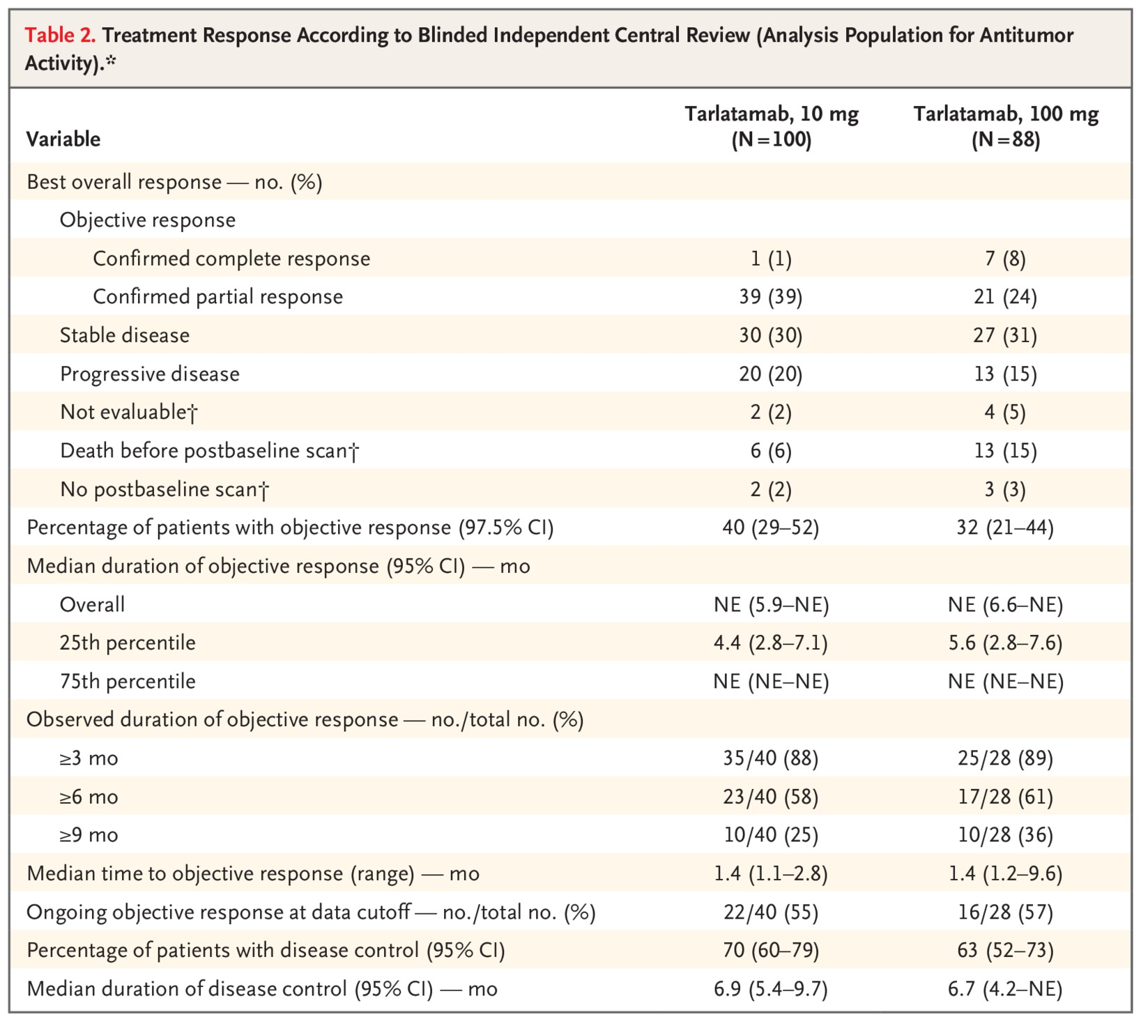
Tarlatamab ORR
Ahn, NEJM 2023
Notes:
Figure 1 Antitumor Activity of Tarlatamab. Panel A shows the time to response, the duration of response, and patient status as of the data cutoff date for all the patients who were assessed as having an objective response (complete or partial response; primary end point) to 10 mg or 100 mg of tarlatamab, as assessed by blinded independent central review according to the Response Evaluation Criteria in Solid Tumors, version 1.1. Panel B shows the Kaplan–Meier curve of progression-free survival in the analysis population for antitumor activity, which included 100 patients who had been assigned to receive 10 mg of tarlatamab in part 1 or part 2 of the trial and 88 patients who had been assigned to receive 100 mg of tarlatamab in part 1 of the trial. Panel C shows the Kaplan–Meier curve of overall survival in the analysis population for antitumor activity. The tick marks in Panels B and C indicate censored data. NE denotes not evaluable.

Slide 34
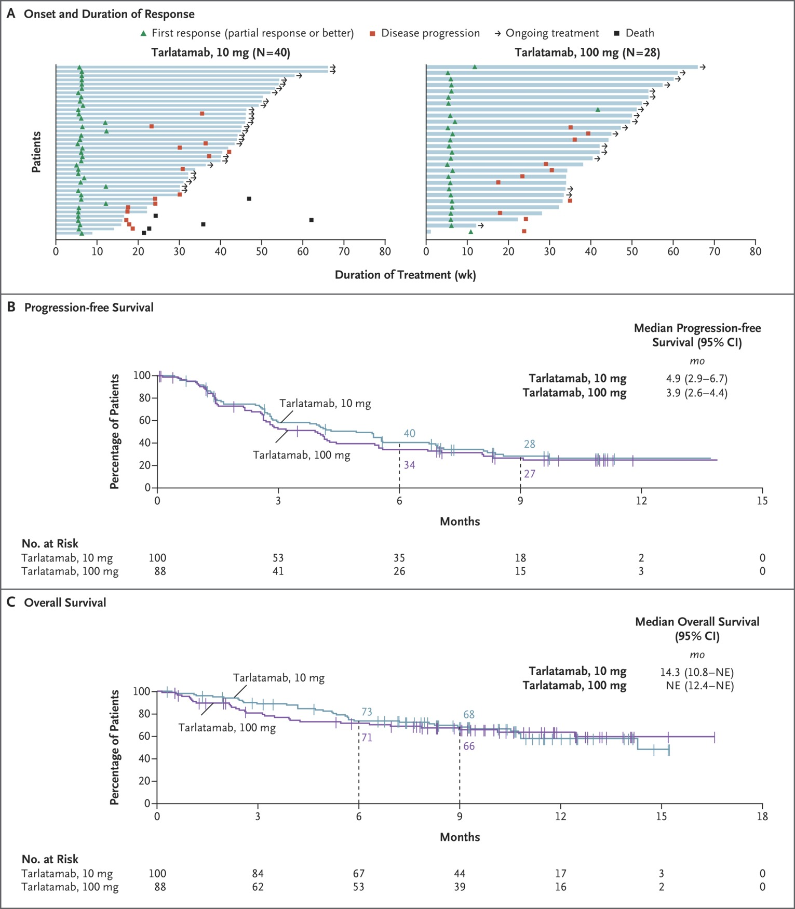
Tarlatamab DOR
Ahn, NEJM 2023
Notes:
Figure 1 Antitumor Activity of Tarlatamab. Panel A shows the time to response, the duration of response, and patient status as of the data cutoff date for all the patients who were assessed as having an objective response (complete or partial response; primary end point) to 10 mg or 100 mg of tarlatamab, as assessed by blinded independent central review according to the Response Evaluation Criteria in Solid Tumors, version 1.1. Panel B shows the Kaplan–Meier curve of progression-free survival in the analysis population for antitumor activity, which included 100 patients who had been assigned to receive 10 mg of tarlatamab in part 1 or part 2 of the trial and 88 patients who had been assigned to receive 100 mg of tarlatamab in part 1 of the trial. Panel C shows the Kaplan–Meier curve of overall survival in the analysis population for antitumor activity. The tick marks in Panels B and C indicate censored data. NE denotes not evaluable.

Slide 35
Tarlatamab PFS and OS
Ahn, NEJM 2023
Notes:
Figure 1 Antitumor Activity of Tarlatamab. Panel A shows the time to response, the duration of response, and patient status as of the data cutoff date for all the patients who were assessed as having an objective response (complete or partial response; primary end point) to 10 mg or 100 mg of tarlatamab, as assessed by blinded independent central review according to the Response Evaluation Criteria in Solid Tumors, version 1.1. Panel B shows the Kaplan–Meier curve of progression-free survival in the analysis population for antitumor activity, which included 100 patients who had been assigned to receive 10 mg of tarlatamab in part 1 or part 2 of the trial and 88 patients who had been assigned to receive 100 mg of tarlatamab in part 1 of the trial. Panel C shows the Kaplan–Meier curve of overall survival in the analysis population for antitumor activity. The tick marks in Panels B and C indicate censored data. NE denotes not evaluable.

Slide 36
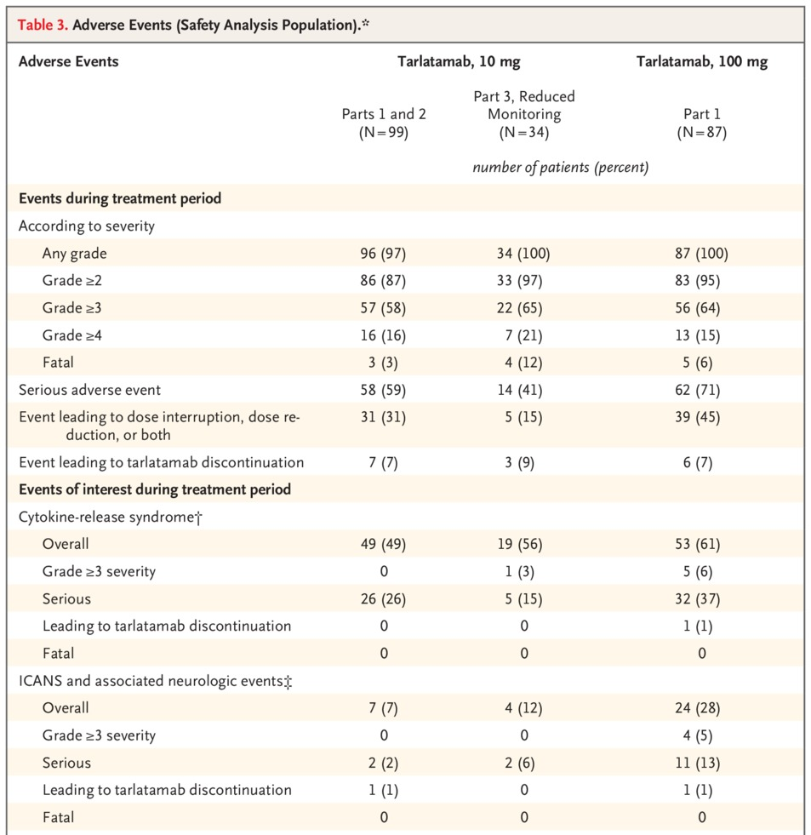
Tarlatamab Safety
Ahn, NEJM 2023
Notes:
Figure 1 Antitumor Activity of Tarlatamab. Panel A shows the time to response, the duration of response, and patient status as of the data cutoff date for all the patients who were assessed as having an objective response (complete or partial response; primary end point) to 10 mg or 100 mg of tarlatamab, as assessed by blinded independent central review according to the Response Evaluation Criteria in Solid Tumors, version 1.1. Panel B shows the Kaplan–Meier curve of progression-free survival in the analysis population for antitumor activity, which included 100 patients who had been assigned to receive 10 mg of tarlatamab in part 1 or part 2 of the trial and 88 patients who had been assigned to receive 100 mg of tarlatamab in part 1 of the trial. Panel C shows the Kaplan–Meier curve of overall survival in the analysis population for antitumor activity. The tick marks in Panels B and C indicate censored data. NE denotes not evaluable.

Slide 37
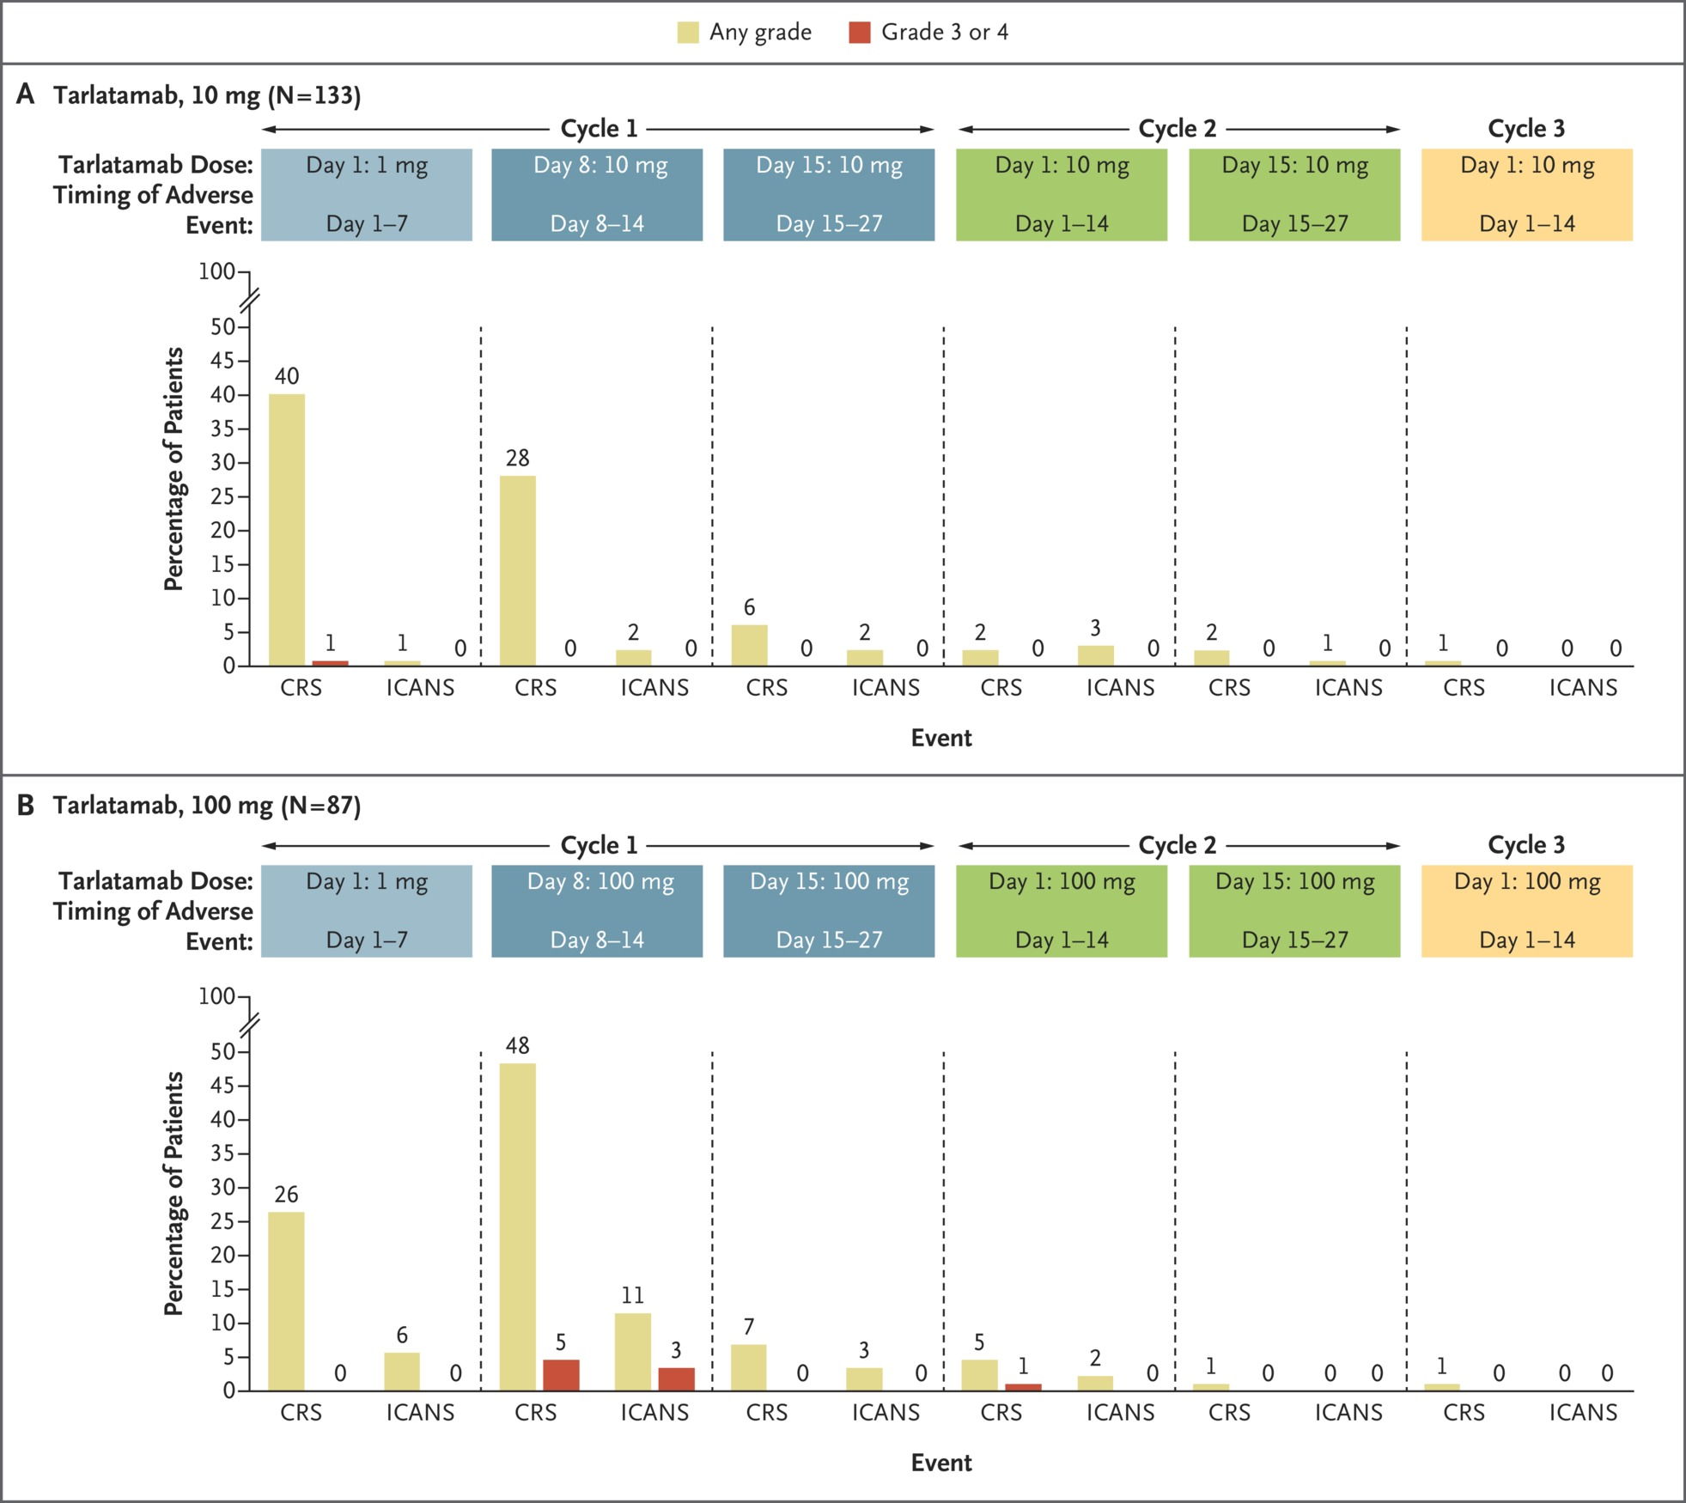
Tarlatamab
Ahn, NEJM 2023
Notes:
Figure 1 Antitumor Activity of Tarlatamab. Panel A shows the time to response, the duration of response, and patient status as of the data cutoff date for all the patients who were assessed as having an objective response (complete or partial response; primary end point) to 10 mg or 100 mg of tarlatamab, as assessed by blinded independent central review according to the Response Evaluation Criteria in Solid Tumors, version 1.1. Panel B shows the Kaplan–Meier curve of progression-free survival in the analysis population for antitumor activity, which included 100 patients who had been assigned to receive 10 mg of tarlatamab in part 1 or part 2 of the trial and 88 patients who had been assigned to receive 100 mg of tarlatamab in part 1 of the trial. Panel C shows the Kaplan–Meier curve of overall survival in the analysis population for antitumor activity. The tick marks in Panels B and C indicate censored data. NE denotes not evaluable.

Slide 38
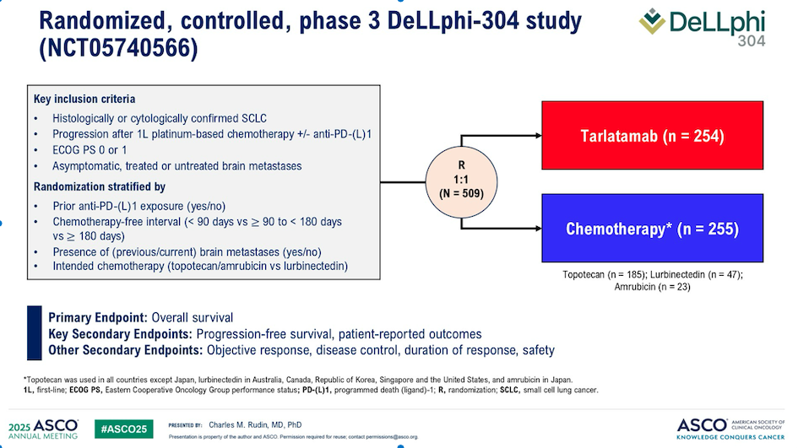

Slide 39
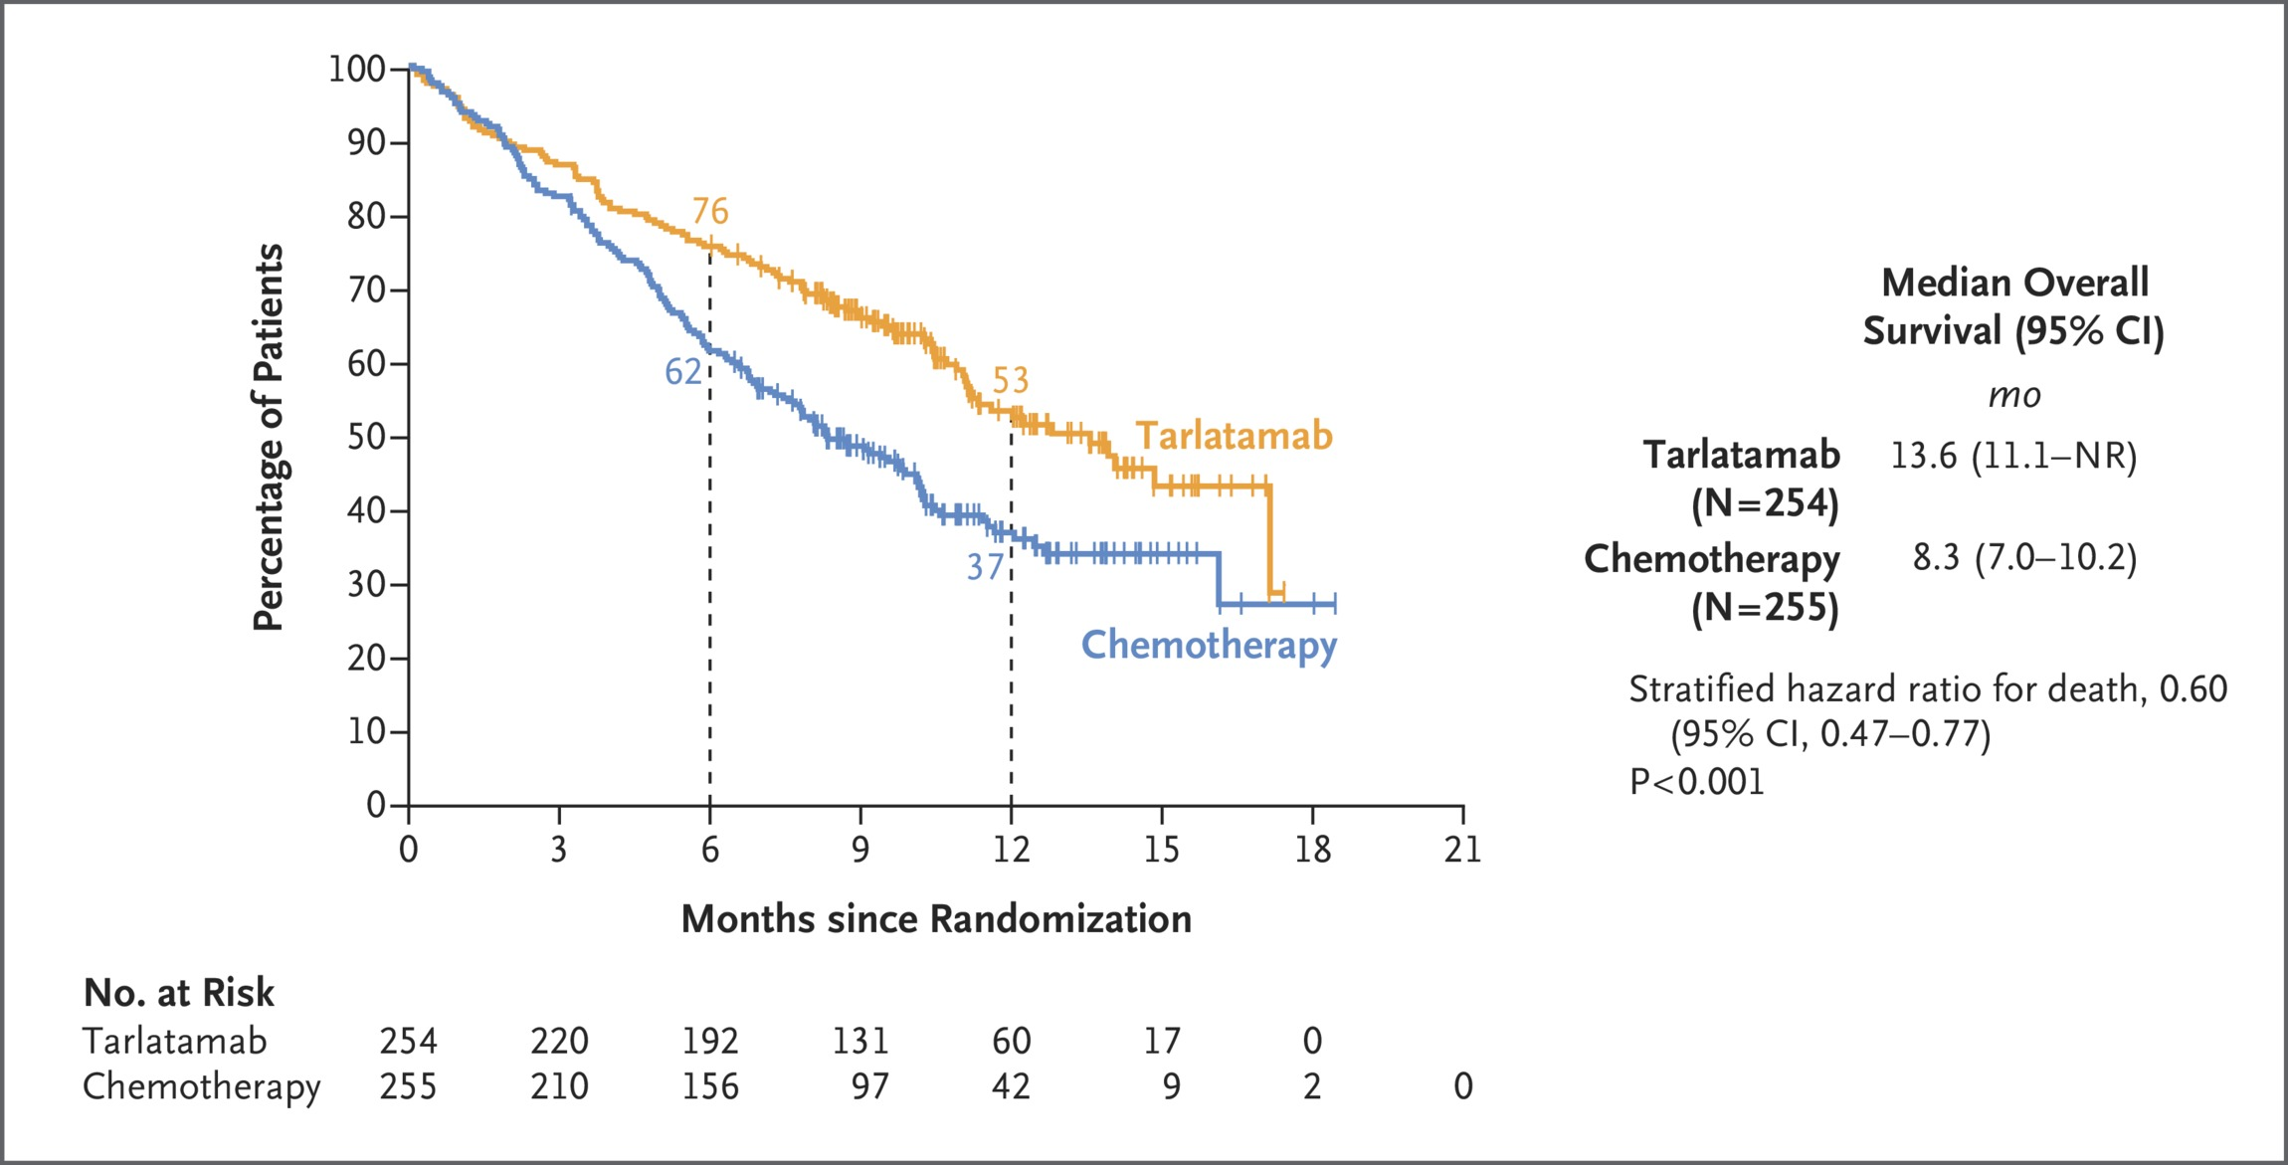
DeLLphi-304 OS
Mountzios, NEJM 2025
Notes:
Figure 1 Antitumor Activity of Tarlatamab. Panel A shows the time to response, the duration of response, and patient status as of the data cutoff date for all the patients who were assessed as having an objective response (complete or partial response; primary end point) to 10 mg or 100 mg of tarlatamab, as assessed by blinded independent central review according to the Response Evaluation Criteria in Solid Tumors, version 1.1. Panel B shows the Kaplan–Meier curve of progression-free survival in the analysis population for antitumor activity, which included 100 patients who had been assigned to receive 10 mg of tarlatamab in part 1 or part 2 of the trial and 88 patients who had been assigned to receive 100 mg of tarlatamab in part 1 of the trial. Panel C shows the Kaplan–Meier curve of overall survival in the analysis population for antitumor activity. The tick marks in Panels B and C indicate censored data. NE denotes not evaluable.

Slide 40
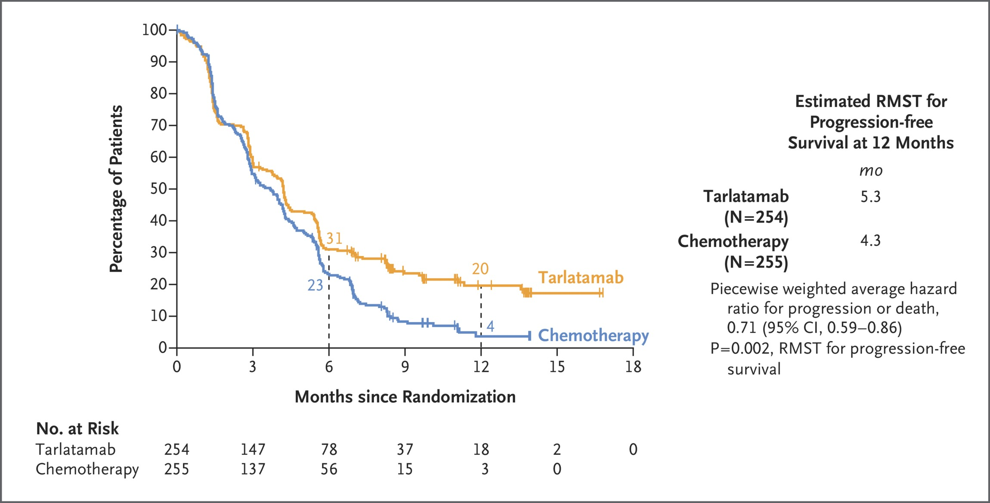
DeLLphi-304 PFS
Mountzios, NEJM 2025
Notes:
Figure 1 Antitumor Activity of Tarlatamab. Panel A shows the time to response, the duration of response, and patient status as of the data cutoff date for all the patients who were assessed as having an objective response (complete or partial response; primary end point) to 10 mg or 100 mg of tarlatamab, as assessed by blinded independent central review according to the Response Evaluation Criteria in Solid Tumors, version 1.1. Panel B shows the Kaplan–Meier curve of progression-free survival in the analysis population for antitumor activity, which included 100 patients who had been assigned to receive 10 mg of tarlatamab in part 1 or part 2 of the trial and 88 patients who had been assigned to receive 100 mg of tarlatamab in part 1 of the trial. Panel C shows the Kaplan–Meier curve of overall survival in the analysis population for antitumor activity. The tick marks in Panels B and C indicate censored data. NE denotes not evaluable.

Slide 41
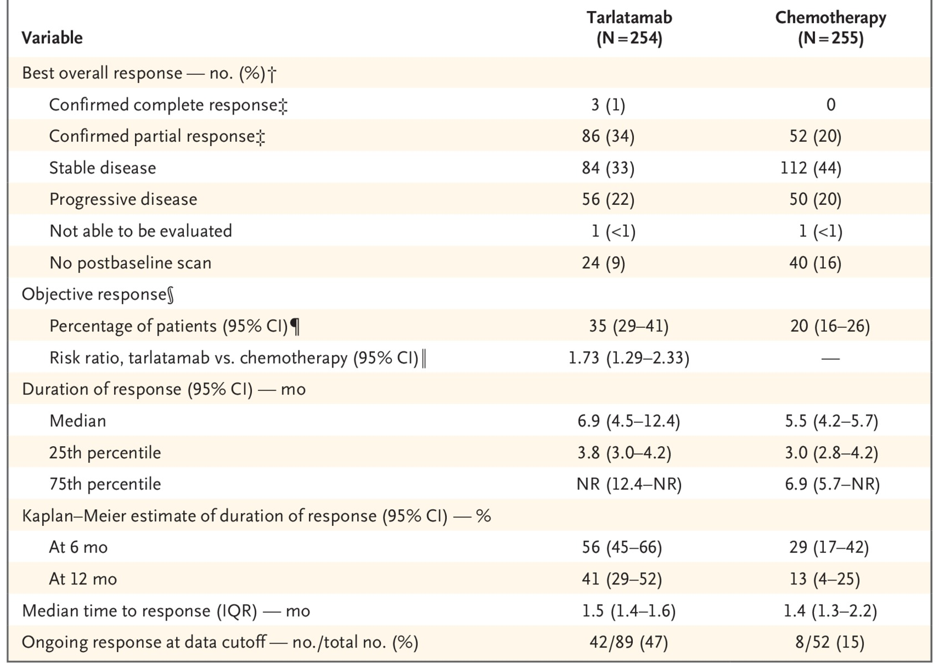
DeLLphi-304 ORR
Mountzios, NEJM 2025
Notes:
Figure 1 Antitumor Activity of Tarlatamab. Panel A shows the time to response, the duration of response, and patient status as of the data cutoff date for all the patients who were assessed as having an objective response (complete or partial response; primary end point) to 10 mg or 100 mg of tarlatamab, as assessed by blinded independent central review according to the Response Evaluation Criteria in Solid Tumors, version 1.1. Panel B shows the Kaplan–Meier curve of progression-free survival in the analysis population for antitumor activity, which included 100 patients who had been assigned to receive 10 mg of tarlatamab in part 1 or part 2 of the trial and 88 patients who had been assigned to receive 100 mg of tarlatamab in part 1 of the trial. Panel C shows the Kaplan–Meier curve of overall survival in the analysis population for antitumor activity. The tick marks in Panels B and C indicate censored data. NE denotes not evaluable.

Slide 42
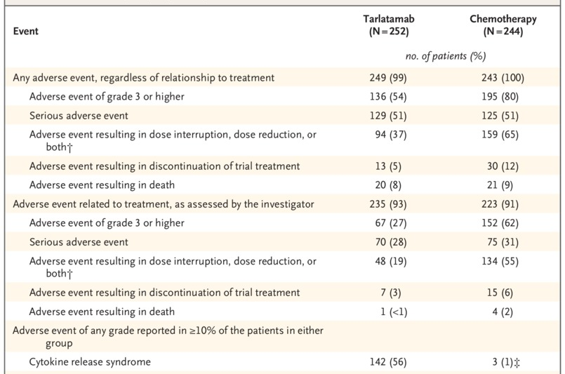
DeLLphi-304 Safety
Mountzios, NEJM 2025
Notes:
Figure 1 Antitumor Activity of Tarlatamab. Panel A shows the time to response, the duration of response, and patient status as of the data cutoff date for all the patients who were assessed as having an objective response (complete or partial response; primary end point) to 10 mg or 100 mg of tarlatamab, as assessed by blinded independent central review according to the Response Evaluation Criteria in Solid Tumors, version 1.1. Panel B shows the Kaplan–Meier curve of progression-free survival in the analysis population for antitumor activity, which included 100 patients who had been assigned to receive 10 mg of tarlatamab in part 1 or part 2 of the trial and 88 patients who had been assigned to receive 100 mg of tarlatamab in part 1 of the trial. Panel C shows the Kaplan–Meier curve of overall survival in the analysis population for antitumor activity. The tick marks in Panels B and C indicate censored data. NE denotes not evaluable.

Slide 43
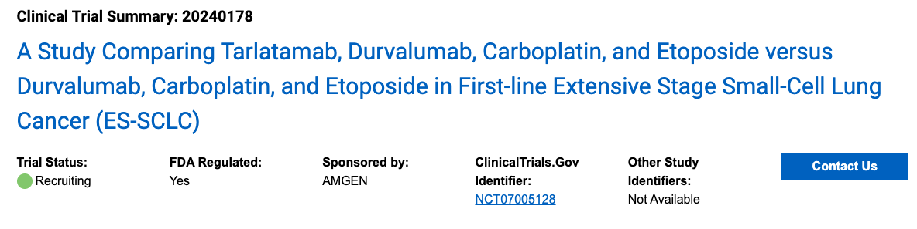
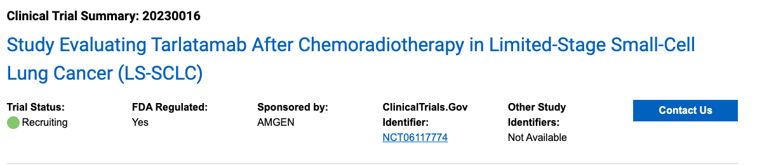
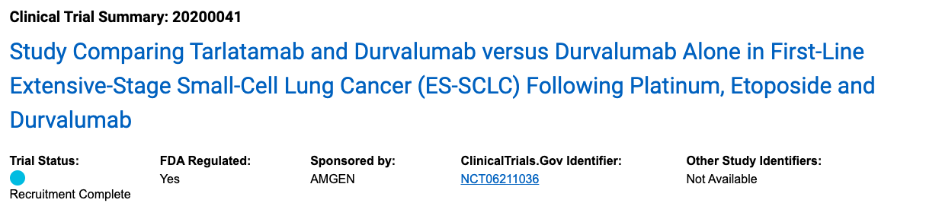
Tarlatamab Trials in Progress
Amgen site, accessed October 2025
Notes:
Figure 1 Antitumor Activity of Tarlatamab. Panel A shows the time to response, the duration of response, and patient status as of the data cutoff date for all the patients who were assessed as having an objective response (complete or partial response; primary end point) to 10 mg or 100 mg of tarlatamab, as assessed by blinded independent central review according to the Response Evaluation Criteria in Solid Tumors, version 1.1. Panel B shows the Kaplan–Meier curve of progression-free survival in the analysis population for antitumor activity, which included 100 patients who had been assigned to receive 10 mg of tarlatamab in part 1 or part 2 of the trial and 88 patients who had been assigned to receive 100 mg of tarlatamab in part 1 of the trial. Panel C shows the Kaplan–Meier curve of overall survival in the analysis population for antitumor activity. The tick marks in Panels B and C indicate censored data. NE denotes not evaluable.

Slide 44
Emerging Therapies

Slide 45
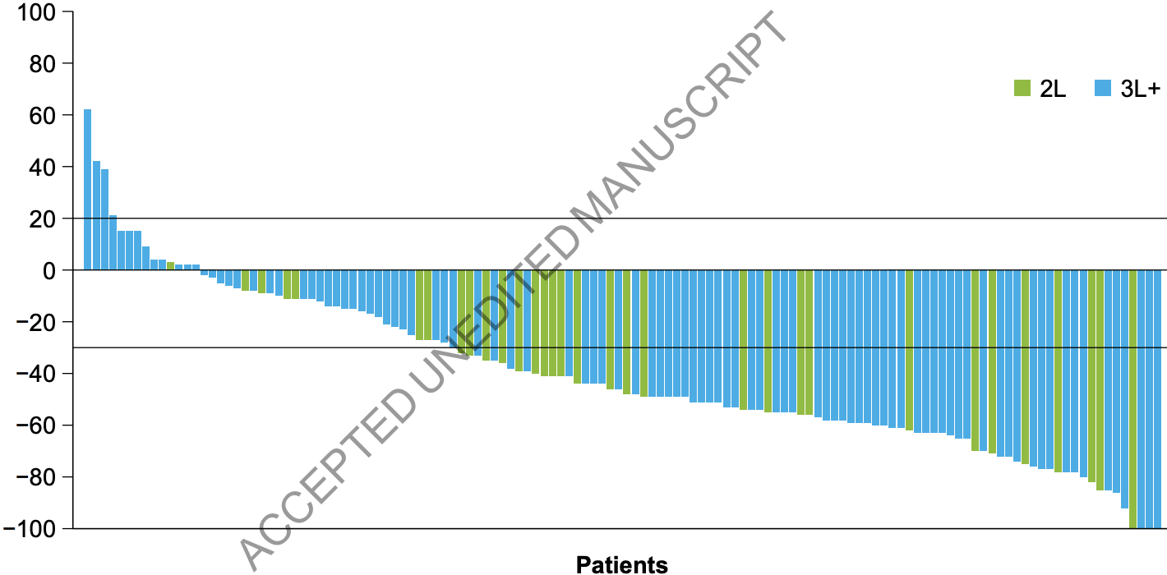
Ifinatamab: B7-H3 ADC
B7H3 (CD276) is a member of the B7 family of immune checkpoint molecules
Rudin, JCO 2025
Notes:
Purpose
Treatment options for patients with recurrent or progressive extensive-stage small-cell lung cancer (ES-SCLC) are limited. This phase 2 trial evaluated the efficacy and safety of ifinatamab deruxtecan (I-DXd), a B7 homolog 3–directed antibody–drug conjugate, in patients with previously treated ES-SCLC.
Methods
Patients were randomized to receive I-DXd 8 or 12 mg/kg intravenously every 3 weeks (Q3W) in part 1 (dose optimization) and received I-DXd 12 mg/kg in part 2 (extension). The primary endpoint was objective response rate by blinded independent central review per Response Evaluation Criteria in Solid Tumours, version 1.1.
Results
Overall, 183 patients received I-DXd: 88 in part 1 (8 mg/kg, n=46; 12 mg/kg, n=42) and 95 in part 2. The median number of prior lines of treatment was two. In the total 12-mg/kg group from parts 1 and 2 (n=137), the confirmed objective response rate was 48.2% (95% confidence interval [CI], 39.6-56.9), median duration of response was 5.3 (95% CI, 4.0-6.5) months, median time to response was 1.4 (range, 1.0-8.1) months, median progression-free survival was 4.9 (95% CI, 4.2-5.5) months, and the 9-month overall survival estimate was 59.1%. Any-grade treatment-related adverse events (TRAEs) occurred in 89.8% of patients (grade ≥3, 36.5%). The most common TRAEs were nausea (43.1%), anemia (34.3%), and neutropenia (34.3%). TRAEs associated with treatment discontinuation and death were reported in 9.5% and 4.4% of patients, respectively. Treatment-related interstitial lung disease (ILD) as determined by the ILD adjudication committee was reported in 12.4% of patients (grade ≥3, 4.4%).
Conclusion
I-DXd 12 mg/kg Q3W showed promising efficacy in patients with previously treated ES-SCLC. The observed safety profile was consistent with previous reports, with no new safety signals identified.

Slide 46
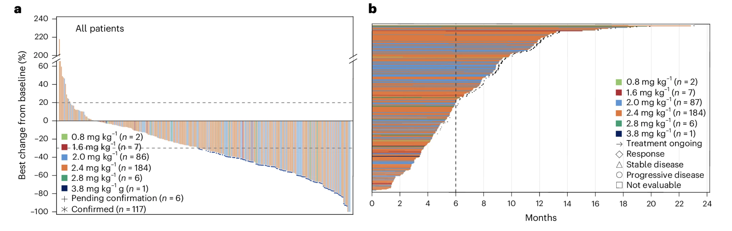
YL201: B7-H3 ADC
Ma, Nat Med 2025
Notes:
Antibody–drug conjugates (ADCs) have emerged as a transformative modality in the treatment of solid tumors. YL201, a novel B7H3-targeting ADC, leverages a tumor microenvironment activable linker-payload platform, coupled with a novel topoisomerase 1 inhibitor via a protease-cleavable linker. Here we report the findings from a large-scale, global, multicenter, phase 1 trial evaluating the safety, pharmacokinetics and preliminary efficacy of YL201 in patients with advanced solid tumors refractory to standard therapies. The trial included a dose-escalation part (phase 1) and a dose-expansion part (phase 1b). A total of 312 patients were enrolled across multiple tumor types, including extensive-stage small cell lung cancer (ES-SCLC), nasopharyngeal carcinoma (NPC), non-small cell lung cancer, esophageal squamous cell carcinoma and other solid tumors. The maximum tolerated dose was determined to be 2.8 mg kg⁻¹, and the recommended expansion dose was selected as 2.0 mg kg⁻¹ and 2.4 mg kg⁻¹ every 3 weeks. The most common grade 3 or higher treatment-related adverse events included neutropenia (31.7%), leukopenia (29.5%) and anemia (25.0%). Only 4 cases of interstitial lung disease (1.3%) and 1 case of infusion reactions (0.3%) were observed. Encouraging anti-tumor activity was observed, particularly in patients with ES-SCLC (objective response rate (ORR), 63.9%), NPC (ORR, 48.6%), lung adenocarcinoma (ORR, 28.6%) and lymphoepithelioma-like carcinoma (ORR, 54.2%). No significant correlation between B7H3 membrane expression and the ORR was found. YL201 demonstrated an acceptable safety profile and a promising efficacy in heavily pretreated patients with advanced solid tumors, particularly in those with ES-SCLC, NPC or lymphoepithelioma-like carcinoma. Phase 3 clinical trials for patients with SCLC and NPC have already been initiated. ClinicalTrials.gov identifiers: NCT05434234 and NCT06057922.

Slide 47
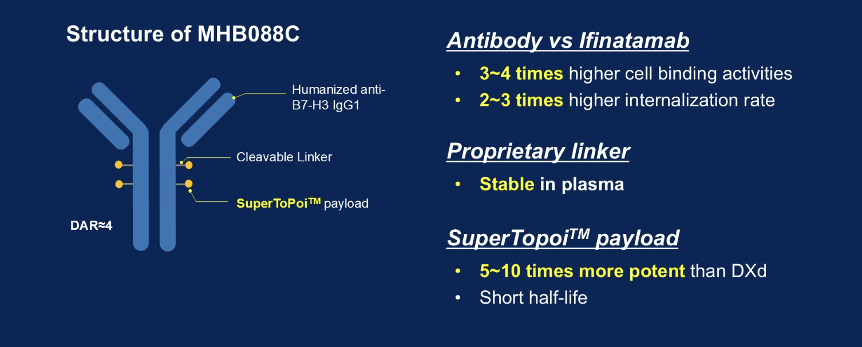
MHB088C: B7-H3 ADC
Shen, ASCO 2025
Notes:
Antibody–drug conjugates (ADCs) have emerged as a transformative modality in the treatment of solid tumors. YL201, a novel B7H3-targeting ADC, leverages a tumor microenvironment activable linker-payload platform, coupled with a novel topoisomerase 1 inhibitor via a protease-cleavable linker. Here we report the findings from a large-scale, global, multicenter, phase 1 trial evaluating the safety, pharmacokinetics and preliminary efficacy of YL201 in patients with advanced solid tumors refractory to standard therapies. The trial included a dose-escalation part (phase 1) and a dose-expansion part (phase 1b). A total of 312 patients were enrolled across multiple tumor types, including extensive-stage small cell lung cancer (ES-SCLC), nasopharyngeal carcinoma (NPC), non-small cell lung cancer, esophageal squamous cell carcinoma and other solid tumors. The maximum tolerated dose was determined to be 2.8 mg kg⁻¹, and the recommended expansion dose was selected as 2.0 mg kg⁻¹ and 2.4 mg kg⁻¹ every 3 weeks. The most common grade 3 or higher treatment-related adverse events included neutropenia (31.7%), leukopenia (29.5%) and anemia (25.0%). Only 4 cases of interstitial lung disease (1.3%) and 1 case of infusion reactions (0.3%) were observed. Encouraging anti-tumor activity was observed, particularly in patients with ES-SCLC (objective response rate (ORR), 63.9%), NPC (ORR, 48.6%), lung adenocarcinoma (ORR, 28.6%) and lymphoepithelioma-like carcinoma (ORR, 54.2%). No significant correlation between B7H3 membrane expression and the ORR was found. YL201 demonstrated an acceptable safety profile and a promising efficacy in heavily pretreated patients with advanced solid tumors, particularly in those with ES-SCLC, NPC or lymphoepithelioma-like carcinoma. Phase 3 clinical trials for patients with SCLC and NPC have already been initiated. ClinicalTrials.gov identifiers: NCT05434234 and NCT06057922.

Slide 48
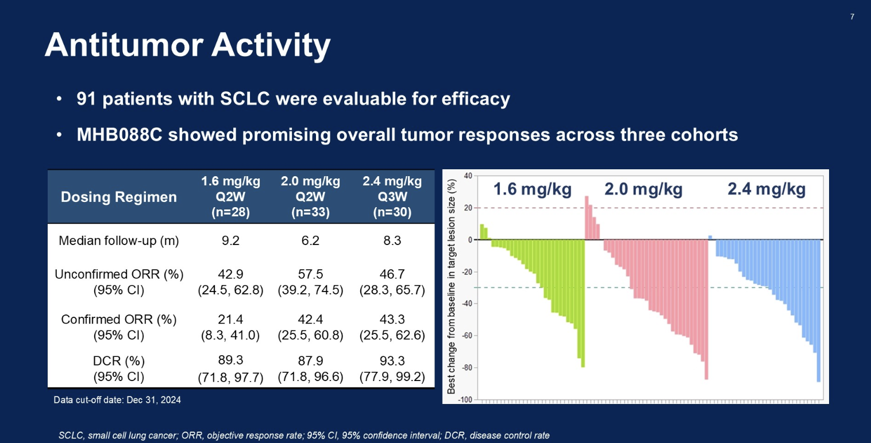
MHB088C: B7-H3 ADC
Shen, ASCO 2025
Notes:
Antibody–drug conjugates (ADCs) have emerged as a transformative modality in the treatment of solid tumors. YL201, a novel B7H3-targeting ADC, leverages a tumor microenvironment activable linker-payload platform, coupled with a novel topoisomerase 1 inhibitor via a protease-cleavable linker. Here we report the findings from a large-scale, global, multicenter, phase 1 trial evaluating the safety, pharmacokinetics and preliminary efficacy of YL201 in patients with advanced solid tumors refractory to standard therapies. The trial included a dose-escalation part (phase 1) and a dose-expansion part (phase 1b). A total of 312 patients were enrolled across multiple tumor types, including extensive-stage small cell lung cancer (ES-SCLC), nasopharyngeal carcinoma (NPC), non-small cell lung cancer, esophageal squamous cell carcinoma and other solid tumors. The maximum tolerated dose was determined to be 2.8 mg kg⁻¹, and the recommended expansion dose was selected as 2.0 mg kg⁻¹ and 2.4 mg kg⁻¹ every 3 weeks. The most common grade 3 or higher treatment-related adverse events included neutropenia (31.7%), leukopenia (29.5%) and anemia (25.0%). Only 4 cases of interstitial lung disease (1.3%) and 1 case of infusion reactions (0.3%) were observed. Encouraging anti-tumor activity was observed, particularly in patients with ES-SCLC (objective response rate (ORR), 63.9%), NPC (ORR, 48.6%), lung adenocarcinoma (ORR, 28.6%) and lymphoepithelioma-like carcinoma (ORR, 54.2%). No significant correlation between B7H3 membrane expression and the ORR was found. YL201 demonstrated an acceptable safety profile and a promising efficacy in heavily pretreated patients with advanced solid tumors, particularly in those with ES-SCLC, NPC or lymphoepithelioma-like carcinoma. Phase 3 clinical trials for patients with SCLC and NPC have already been initiated. ClinicalTrials.gov identifiers: NCT05434234 and NCT06057922.

Slide 49
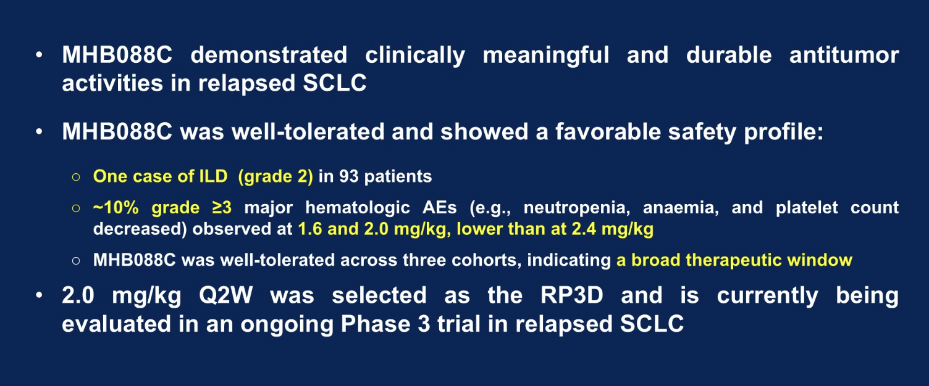
MHB088C: B7-H3 ADC
Shen, ASCO 2025
Notes:
Antibody–drug conjugates (ADCs) have emerged as a transformative modality in the treatment of solid tumors. YL201, a novel B7H3-targeting ADC, leverages a tumor microenvironment activable linker-payload platform, coupled with a novel topoisomerase 1 inhibitor via a protease-cleavable linker. Here we report the findings from a large-scale, global, multicenter, phase 1 trial evaluating the safety, pharmacokinetics and preliminary efficacy of YL201 in patients with advanced solid tumors refractory to standard therapies. The trial included a dose-escalation part (phase 1) and a dose-expansion part (phase 1b). A total of 312 patients were enrolled across multiple tumor types, including extensive-stage small cell lung cancer (ES-SCLC), nasopharyngeal carcinoma (NPC), non-small cell lung cancer, esophageal squamous cell carcinoma and other solid tumors. The maximum tolerated dose was determined to be 2.8 mg kg⁻¹, and the recommended expansion dose was selected as 2.0 mg kg⁻¹ and 2.4 mg kg⁻¹ every 3 weeks. The most common grade 3 or higher treatment-related adverse events included neutropenia (31.7%), leukopenia (29.5%) and anemia (25.0%). Only 4 cases of interstitial lung disease (1.3%) and 1 case of infusion reactions (0.3%) were observed. Encouraging anti-tumor activity was observed, particularly in patients with ES-SCLC (objective response rate (ORR), 63.9%), NPC (ORR, 48.6%), lung adenocarcinoma (ORR, 28.6%) and lymphoepithelioma-like carcinoma (ORR, 54.2%). No significant correlation between B7H3 membrane expression and the ORR was found. YL201 demonstrated an acceptable safety profile and a promising efficacy in heavily pretreated patients with advanced solid tumors, particularly in those with ES-SCLC, NPC or lymphoepithelioma-like carcinoma. Phase 3 clinical trials for patients with SCLC and NPC have already been initiated. ClinicalTrials.gov identifiers: NCT05434234 and NCT06057922.

Slide 50
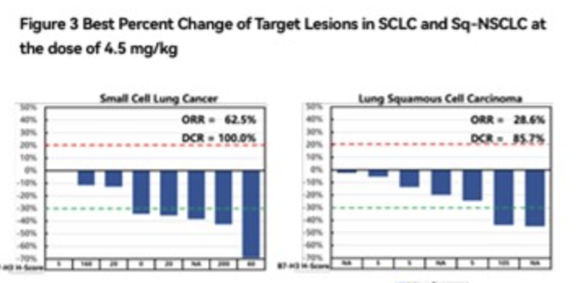
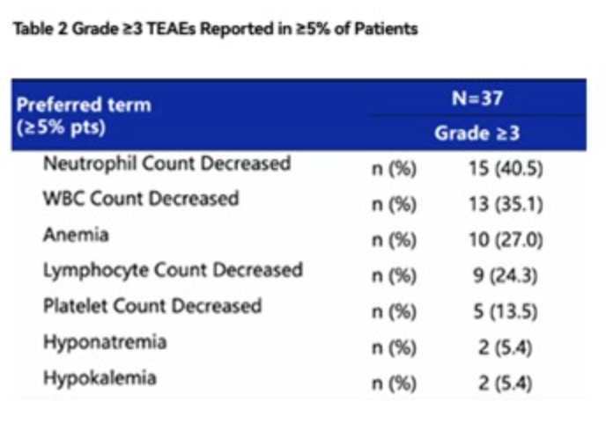
7MW3711: B7-H3 ADC
    N=37 (21 NSCLC/16 SCLC)
    ORR: S-NSCLC 37.5% (3/8) / SCLC 87.5% (7/8)
Li, ASCO 2025

Slide 51
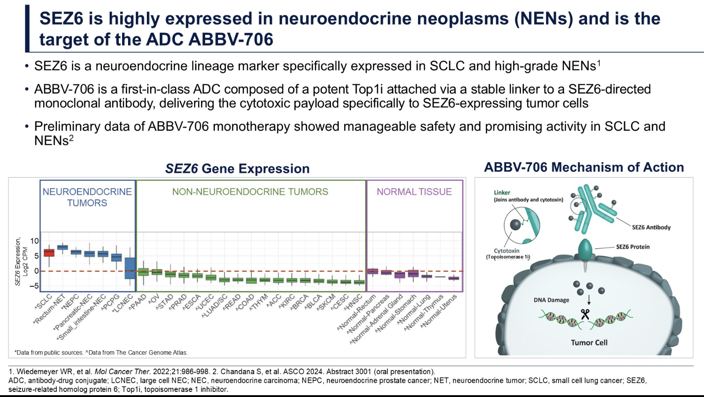
Seizure-Related Homolog (SEZ6)
Cooper, ASCO 2025

Slide 52
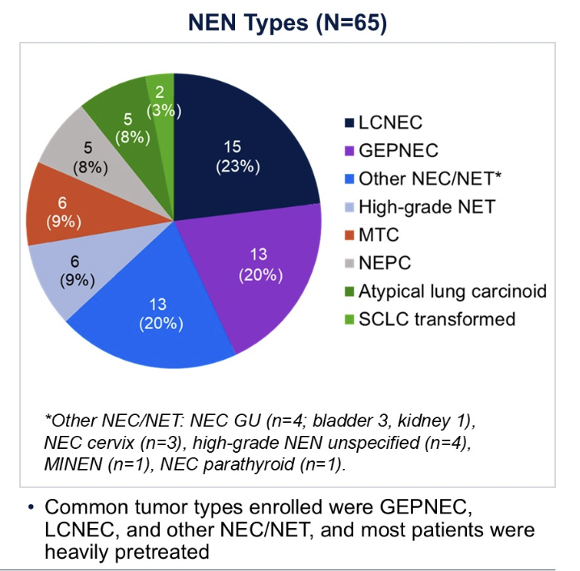
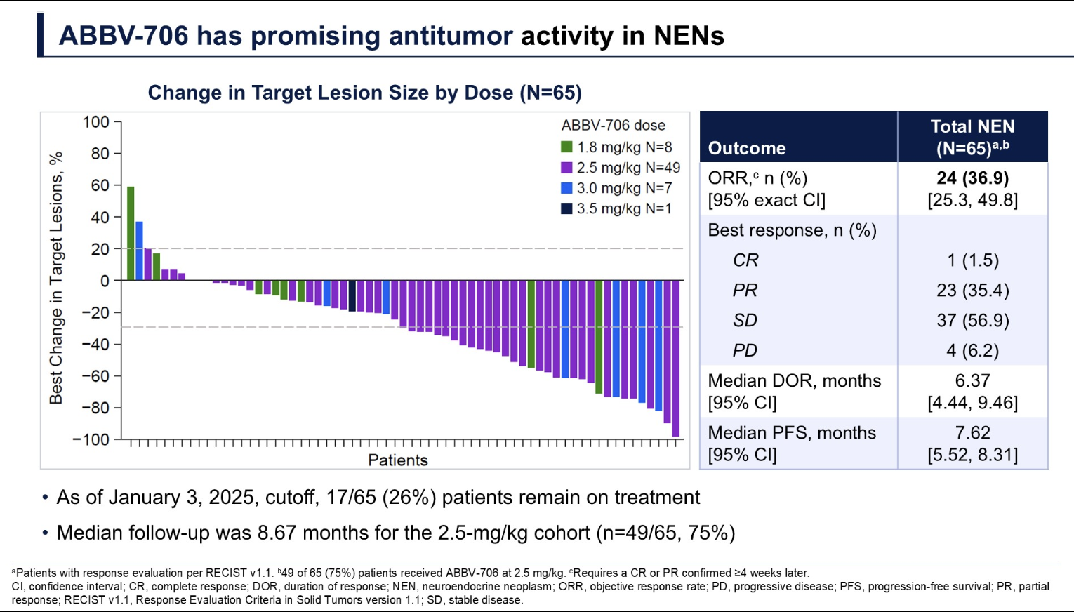
ABBV-706: SEZ6 ADC
Cooper, ASCO 2025

Slide 53
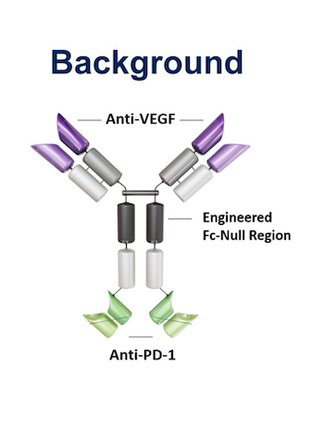
Ivonescimab
Zhang, ASCO 2024

Slide 54
Take-Aways
Durvalumab is now standard in LS-SCLC (x 2yrs)
Lurbinectidin is FDA-approved for 1st-Line Maintenance use
Tarlatamab is now standard for relapsed SCLC – and likely will move into a First-Line setting in the future (? 1-2yrs)
David R. Spigel, M.D.
Notes:
Pushing cancer down the road is a good thing if the ‘costs’ are acceptable

Slide 55
Thank You

